Slide 1
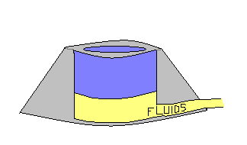
Regular coring needle
« Huber » non-coring needle

