Slide 1
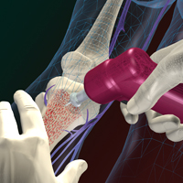
INTRAOSSEOUS VS TRADITIONAL VASCULAR ACCESS
Vidacare, 2011
Reanne Ashley LPN, Debi Davis LPN, Aaron Houston RN, Karla Stamper LPN, and Melissa Paschal LPN
College Of Nursing, University of Oklahoma 2011
Notes:
Good Morning/Afternoon,
My name is Debi and this is Reanne, Aaron, Karla and Melissa.
In our presentation today we will be discussing Intraosseous vascular compared to traditional vascular access.

Slide 2
Identification of the Problem
IV access can be difficult to obtain in the following situations: hemodynamically unstable, cardiac arrest, trauma, morbidly obese, severely dehydrated, hypovolemic, burns, etc….
The lack of immediate vascular access can lead to unnecessary morbidity or mortality.
Notes:
Define Intraosseous Vascular Access, Discuss history (1920’s -

Slide 3
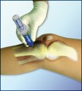
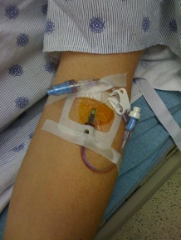
PICO QUESTION
“ IO vs. traditional IV access devices in the adult population. Which is most appropriate?”
Vidacare, 2011
Notes:
Our PICO question is (read question)

Slide 4
PICO DEFINED
Population of Interest- Adult patients where IV access was difficult or impossible to obtain.
Intervention of Interest- Placement of Intraosseous device as opposed to other types of vascular access such as peripheral IV or central line.
Comparison of Interest- Current practice for vascular access uses either peripheral or central lines.
Outcome of Interest- Vascular access for adult patients that can be placed quickly and is cost effective.

Slide 5
Why Is This A Problem
CVC’s have a high incidence of infection and increased length of hospital stay
IO devices have a historical low complication rate
IO insertion time significantly less than central line
IO is cost effective

Slide 6
Statistics of Problem & Cost
Total cost of IO kits range from $37 to $580
Manual insertion success rates range from 76%-94%
Impact Driven success rates range from 55% to 94%
EZ IO success ranges from 94% to 97%
Notes:
Cost of kits- manual device only $37. EZ-IO Kit $580.

Slide 7
Statistics of Problem & Cost
EZ IO insertion time averages 4.5 to 10 seconds
Central Line insertion time averages 5 to 17 minutes
Peripheral IV insertion time averages 2.5 to 13 minutes

Slide 8
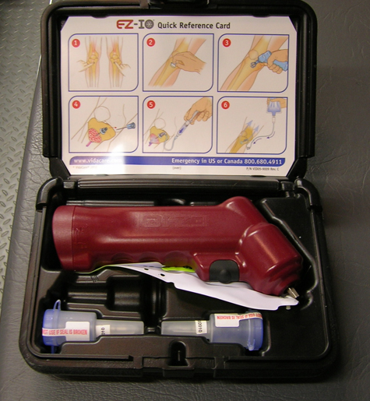
Literature Review
Leidel (2009) studied a group of 10 adults over the age of 18 in the ER.
Results: Researchers found that the IO device is much more reliable and faster than the CVC.
Vidacare, 2011

Slide 9
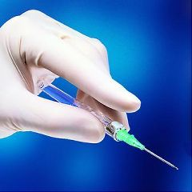
Literature Review
Luck (2010) studied adult patients over the age of 16. Sample size was not given.
Results: Study showed that IO devices provide a safe and reliable way to gain vascular access in the critically ill or injured patient.

Slide 10
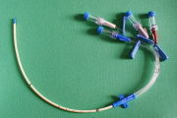
Literature Review
Phillips (2010) reviewed more than 20 studies focusing on adult patients in the emergent and nonemergent setting.
Results: IO access as an alternative to IV access can reduce the morbidity and mortality for patients in a variety of healthcare settings.

Slide 11
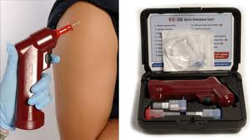
Literature Review
Su-Yin Ngo (2009) studied 24 patients at least 16 years of age or weighing more than 40kg.
Results: IO is a fast and useful alternative when conventional IV access fails or when patients have no venous access.
Vidacare, 2011

Slide 12
Literature Review
Von Hoff (2008) studied 25 adult patients 18 years or older with a confirmed diagnosis of cancer.
Results: Showed no significant difference in plasma concentration levels of morphine when administered via both IO and traditional IV routes

Slide 13
PROS of Intraosseous
Reduced morbidity and mortality
Quicker insertion time
Low complication rate
Cost effective
Radiology confirmation of placement
not required
Vidacare,2011

Slide 14
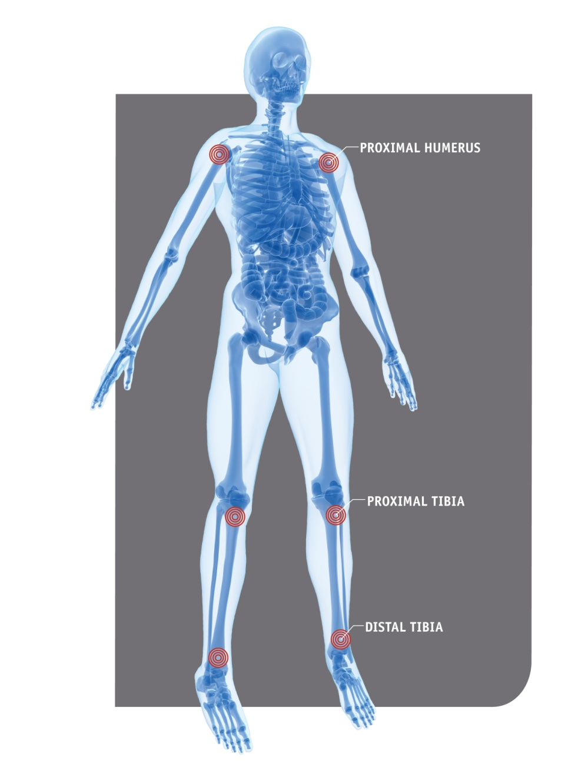
CONS OF Intraosseous
Limited access sites
Access sites must be changed every 24 hours
Painful insertion process
Device not appropriate for all patients
Vidacare, 2011

Slide 15
Recommendation
Based on the evidence, we recommend the addition of intraosseous devices to current policies and practice in situations where IV access is either difficult or impossible to obtain.

Slide 16
Evaluation Methods
Conduct survey of healthcare providers implanting the devices regarding the ease and quick insertion time.
Hospital conducts quarterly reviews on morbidity and mortality to determine whether IO placement has had the desired effect of lowering rates.
Review patient’s medical record after discharge to determine success rate of IO insertion and any related complications.

Slide 17
Suggestions for Further Study
Additional research is required before the implementation of new guidelines.
Additional research should include:
A larger and more varied sample size in a variety of clinical settings
Further evaluation of the safety and efficacy of intraosseous (IO) devices in all practice settings
The impact of cost of intraosseous devices on patient care

Slide 18
REFERENCES
Leidel, B.A., Kirchhoff, C., Bogner, V., Stegmaier, J., Mutschler, W., Kanz, K.G., Braunstein, V. (2009). Is the intraosseous access route fast and efficacious compared to conventional central venous catheterization in adult patients under resuscitation in the emergency department? A prospective observational pilot study. Patient Safety in Surgery 3(24). doi:10.1186/1754-9493-3-24
Luck, R.P., Haines, C., Mull, C.C., (2010). Intraosseous access. Journal of Emergency Medicine 39(4), 468-475. doi:10.1016/j/jemermed.2009.04.05

Slide 19
REFERENCES
Phillips, L., Proehl, J., Brown, L., Miller, J., Campbell, T., Youngberg, B. (2010). Recommendations for the use of intraosseous vascular access for emergent and nonemergent situations in various health care settings; A consensus paper. Journal of Infusion Nursing 33(6). doi: 10.1097/NAN.0b013e3181f91055
Su-Yin Ngo, A., Oh, J.J., Chen, Y., Yong, D., Eng Hock Ong, M. (2009). Intraosseous vascular access in adults using the EZ-IO in an emergency department. International Journal of Emergency Medicine (2), 155-160.doi:10.1007/s12245-009-0116-9

Slide 20
REFERENCES
Vidacare EZ-IO. (2011). Retrieved April 8, 2011, from Vidacare Corporation: http://www.vidacare.com/EZ-IO/Index.aspx
Von Hoff, D.D., Kuhn, J.G., Burris, H.A., Miller, L.J. (2008). Does intraosseous equal intravenous? A pharmacokinetic study. American Journal of Emergency Medicine 26, 31-38.
doi: 10.1016/j.ajem.2007.03.024

